Slide 1
Technical Writing Process & Product
Steven M. Gerson
Sharon J. Gerson

Slide 2
The Writing Process
Prewrite
Write- draft, organize, format
Rewrite/Edit

Slide 3
Prewriting -Objectives
Examining your purpose-
External Motivation
internal motivation
2.Determining your goals-
Persuade an audience to accept your view-brochure/fliers/letter of complaint
Instruct an audience by directing actions
Inform an audience of facts, concerns ,or questions you might have letters/mails
build trust and rapport- courtesy
3.Considering your audience
4. Gathering your data
5. Determining how the content will be provided

Slide 4
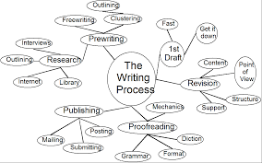
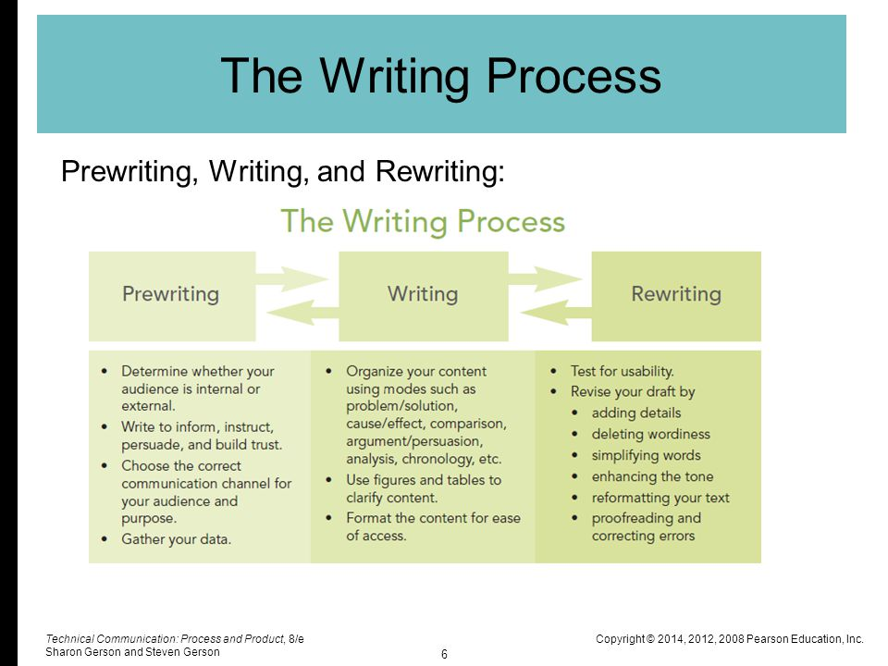
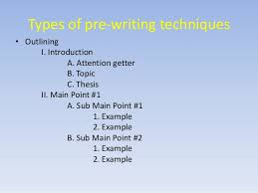
Gathering the data
Answering the reporter’s questions
Mind mapping
Brainstorming or listing
Outlining
Storyboarding
Creating organization charts
Flow charting
Researching

Slide 5
Determining how the content will be provided
Single sourcing- “Producing documents designed to be recommended and reused across projects and various media”.(Carter 2003,317)

Slide 6
Writing
Organization-space, chronology, importance, comparison, problem/solution
Formatting
Rewriting-
Add any missing detail for clarity
Delete dead words
Simplify unnecessary complex words
Reformat
Enhance the tone
Correct any errors

Slide 7
Patterns of organization
Spatial- as it is/ according to the directions for describing a place
At the basement’s northwall,I will build a window seat 7 feet long by 2 feet wide by 2 feet high. To the right of this seat, on the east wall, I will build a desk 4 feet high by 5 feet long by 3 feet wide.
Chronological- to document steps in an instruction. At 9 o clock the meeting ….
Importance- location.- one third from the top of the page and two-thirds from the bottom.
e.g. Agenda
Miscellaneous ideas
Questions from the audience
Refreshments
Location, date, and time
Subject Matter
Guest Matters

Slide 8
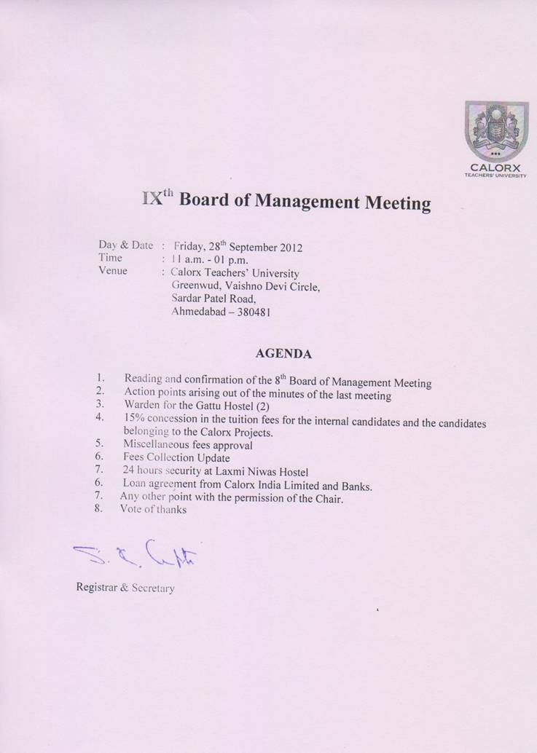

Slide 9
Subject matter
Guest Speakers
Location, date, time
Refreshments
Questions from the audience
Miscellaneous

Slide 10
Comparison/Contrast
Item Features Cost
Problem/solution: problem and the solution to it.

Slide 11
Clarity
Delete obscure words e.g
Issuance- issue
Ascertain- find out
Cognizant-know
Remittance- pay
Disclose-show
Pertain to- about
Obtain- get
In lieu of- instead of

Slide 12
Do not use acronyms, abbreviations and jargons
E.g
CIA- cash in advance
Spaghetti- jargon for hoses and lines
Use verbs in active voice
It has been decided that Joan Smith will head our Metrology Department.
Conciseness

Slide 13
Proof reading tips
Let someone else read it
Use the gestation approach
Read one line at a time
Use technology
Double check figures, numerical, equations
Read it aloud
Try scattershot proofing
Use a dictionary

Slide 14
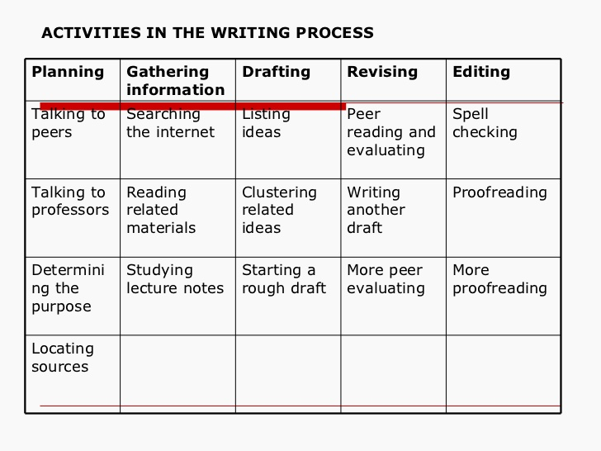

Slide 15
Fog Index
Count number of words per sentence
Divide it by no. of sentences( it gives the avg.)
Count the no. of multisyllabic words
Add them. Then multiply the total by 0.4.

Slide 16
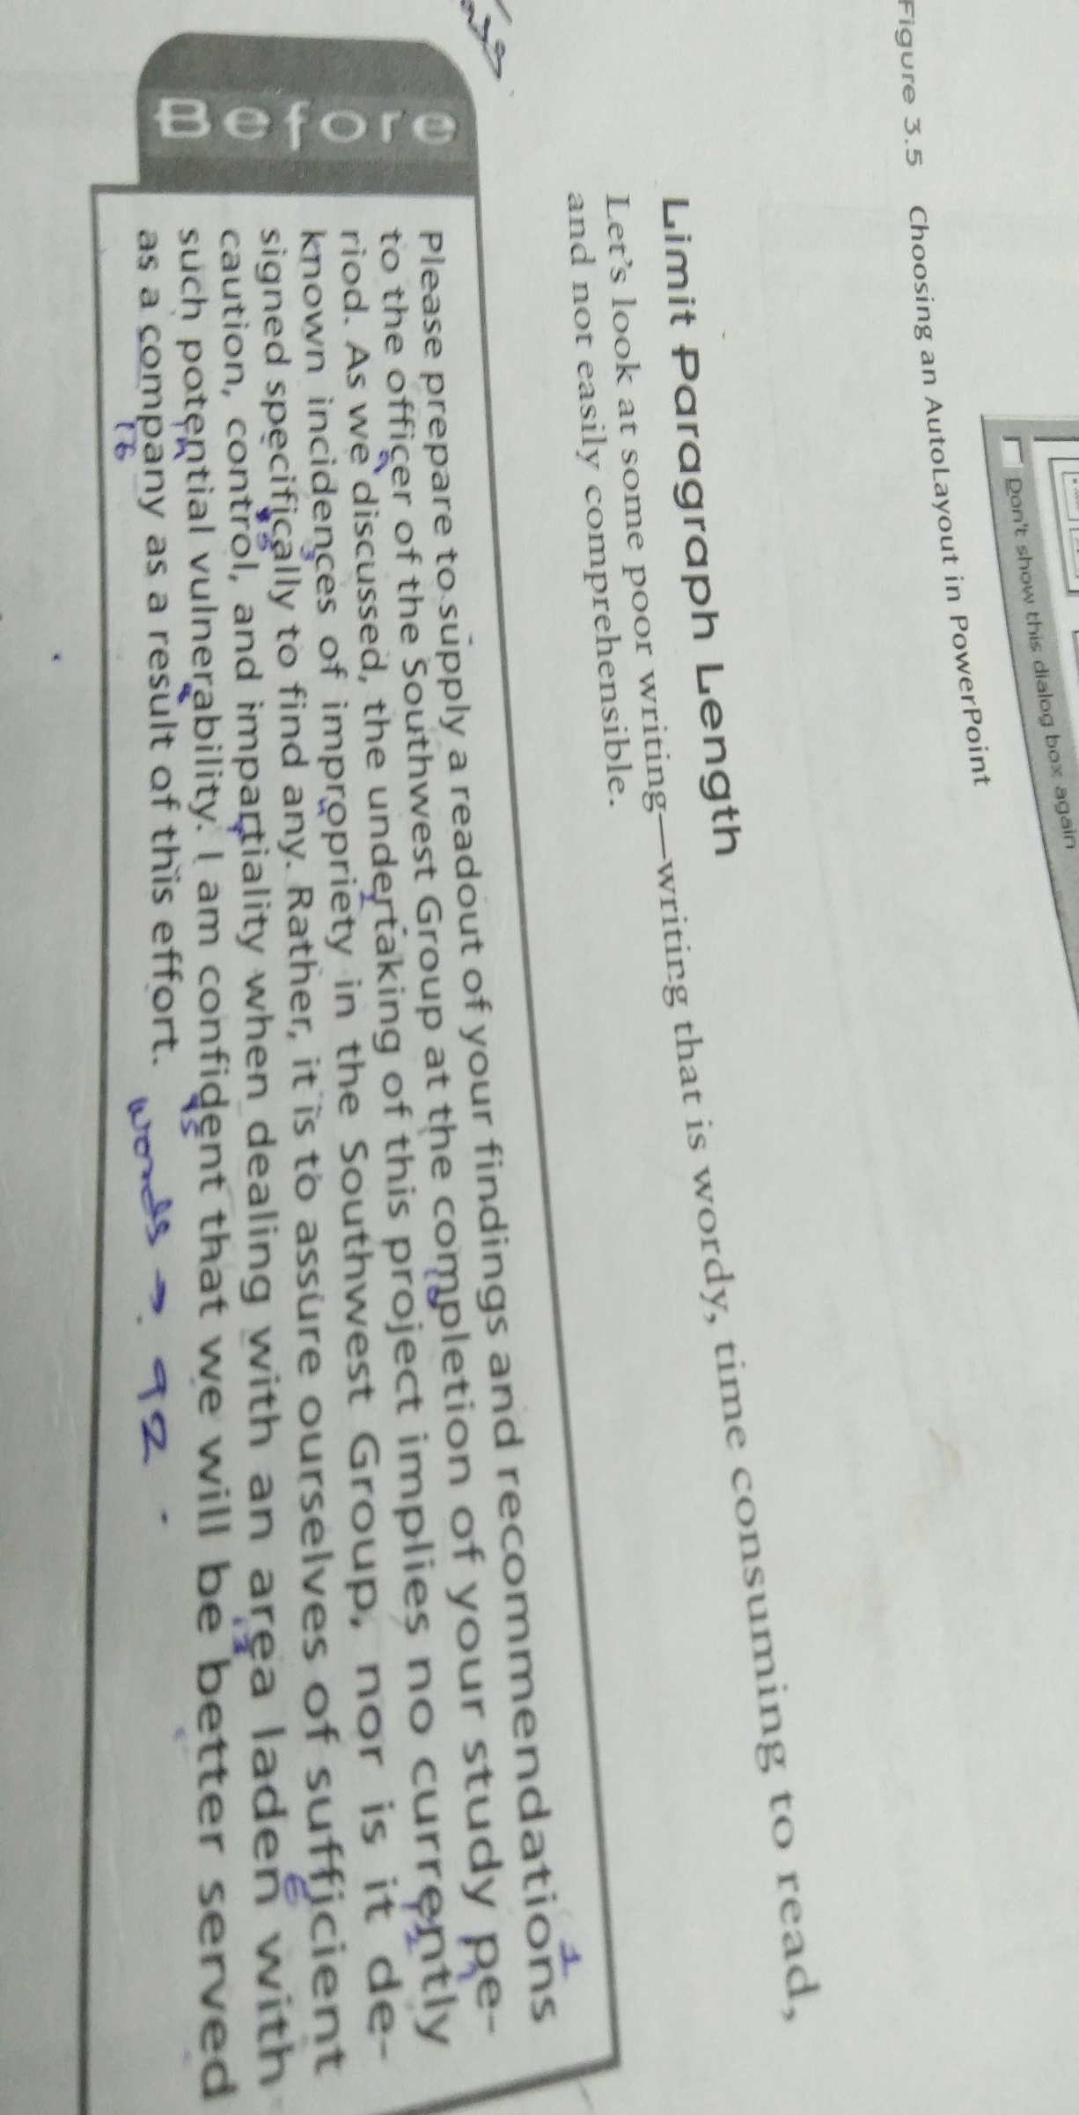

Slide 17
Use only 15 words per sentence and not more than 5 multisyllabic words per 100 words.
15+5=20
20x0.4=8

Slide 18
SINCE John Snow, a rail-company boss, was picked this week to replace Paul O’Neill as America’s treasury secretary, the talk in economic and financial circles has been all about the effect his appointment might have on economic policymaking. Among staffers at the Federal Reserve, though, much of the gossip continues to be about when—and whether—they themselves will get a new boss. The central bank’s current chairman, Alan Greenspan, has been in the job since 1987; his current term expires in 2004. So, along with many Fed-watchers, insiders want to know whether Mr Greenspan will, if he seeks to, be reappointed.

Slide 19
Avoid the Expletive pattern
There is, are, was,were will be, it is ,was.
There are three people who will work for ACME.
It has been decided that ten engineers will be hired.

Slide 20
Ethics
Legal- focussing on liability, negligence and consumer protection laws. Ask lawyers. Customers might be your kith & kin.
Practical- condour-truthful. Making money the right way.
Ethical- written to promote customer welfare and avoid deceiving the end user.

Slide 21
Guide for Ethical standards
Use language and visuals with precision-
Any information is covered under copyrights, obtain permission, cite the source, create your own graphics, copyright your information.
Prefer simple, direct expression of ideas
Satisfy the audiences need for information not my own need for self expression
Respect the work of colleagues
Confidentiality
courtesy
Copyright

Slide 22
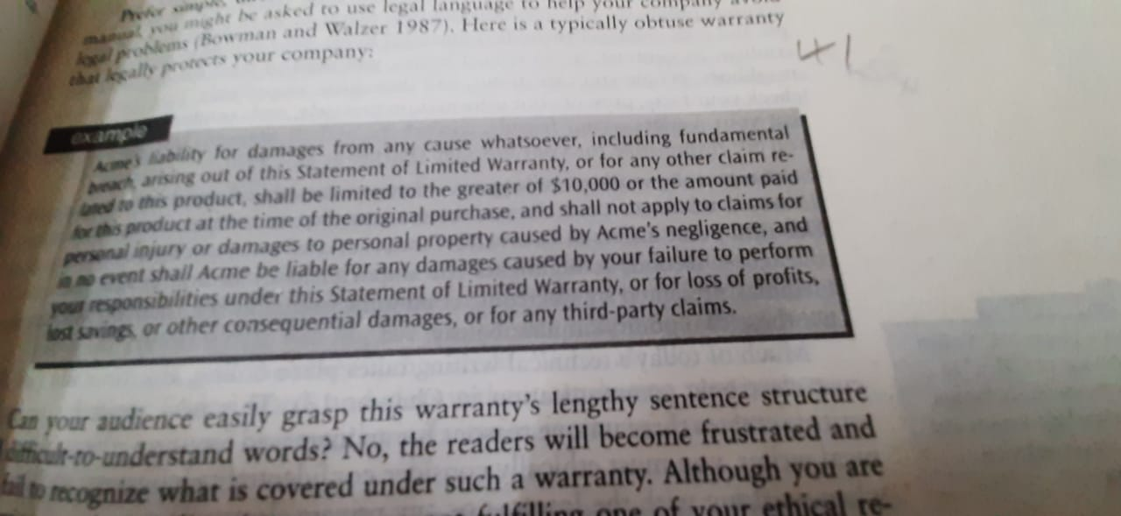
Guide for Ethical standards

Slide 23
Strategies for making ethical decisions
Define the problem-is the problem ethical,legal or practical?
Determine your audience-who will be effected by your problem?
Maximize values, minimize problems
Consider the big picture
Write your text
Use precise language
Use simple words and sentences.
Satisfy the need for information
Take responsibility of your content
Respect confidentiality of your customer, colleague
Promote professionalism and good judgement
"If the primary seal were to fail from . . .330-660 milliseconds the chance of the second seal holding is small. This is a direct result of the o-ring's slow response compared to the metal case segments as the joint rotates" (Winsor

Slide 24
Strategies for making ethical decisions
https://www.slideshare.net/rociobautista/plagiarism-ppt-81071937

